Slide 1


|| Jai Sri Gurudev ||
SJC INSTITUTE OF TECHNOLOGY
DEPARTMENT OF ELECTRONICS AND COMMUNICATION ENGNEERING
8th Sem Major-Project Final Review 2025
“RECOGNITION OF ANTI-MOLESTATION SITUATION USING VOICE AND MACHINE LEARNING”
Project Team Members Project Guide
Name: USN: ANIL KUMAR R
MUSHARAF BAIG 1SJ21EC085 ASSISTANT PROFESSOR
M.BHARGAVA NAIDU 1SJ21EC075 ECE DEPARTMENT
NARA MANISHA 1SJ21EC091
PALLAVI C N 1SJ21EC106
Date: 27-05-2025

Slide 2
1. Abstract 2. Problem Statement 3. Objective 4. Literature Review 5. Methodology 6. Block Diagram 7. Expected Result 8. Applications 9. Reference
INDEX
27-05-2025
SJC Institute of Technology, Chickballapur

Slide 3
Abstract
In today's world, ensuring public safety is a growing concern, especially in cases of harassment and emergency situations. This project presents an AI-driven surveillance system capable of recognizing distress sounds, such as screams, and automatically triggering alerts for quick intervention. By integrating machine learning and real-time audio-video processing, the system enhances security monitoring in public and private spaces.
The model leverages Librosa for audio analysis, PyTorch for deep learning, and OpenCV for CCTV integration, ensuring accurate detection of critical situations. Upon detecting a distress sound, the system instantly captures video evidence and sends alerts to concerned authorities, reducing response time and improving emergency handling. A Node.js-powered notification system and MySQL database manage event records for further analysis and reporting.
This solution is particularly useful in public areas, schools, workplaces, hospitals, and smart city surveillance systems, where rapid response to distress situations is crucial. The automated approach minimizes human effort in monitoring while increasing efficiency in threat detection.
By bridging the gap between AI technology and real-world safety measures, this system contributes to a smarter, faster, and more reliable security framework. Future enhancements could include improving detection accuracy, expanding language support for distress recognition, and integrating advanced video analytics for better threat assessment.

Slide 4
Problem-Statement
Molestation and harassment cases continue to be a critical societal issue, affecting individuals in public and private spaces.
Traditional security measures, such as CCTV surveillance and emergency helplines, often fail to provide real-time intervention due to delayed reporting, lack of immediate response, and dependence on human monitoring.
Victims may not always be able to physically call for help, making it crucial to develop an automated, AI-driven system that can detect distress situations and trigger alerts without manual intervention.

Slide 5
Objectives
To develop a system that recognizes distress sounds, such as screams, during emergencies or harassment situations.
To integrate the voice recognition module with cameras for seamless and continuous monitoring.
Automate the recording of evidence and sending of alerts to the nearest police station.
Optimize notifications to ensure authorities are alerted promptly for Swift intervention.
To enhance public safety by deterring harassment and fostering a secure environment.

Slide 6
Literature Survey
S K Singh (2020) – Molestation Detection using Machine Learning: This paper proposes a machine learning-based approach for detecting molestation situations using text data .The authors use a combination of natural language processing (NLP) and machine learning techniques to classify text data as molestation or non-molestation . The proposed system achieves an accuracy of 92.5% on a dataset of 1,000 text samples.
A.K Jain (2019) – Image-based Molestation Detection using Deep Learning: This paper proposes a deep learning-based approach for detecting molestation situations using image data . The authors use a convolutional neural network (CNN) to classify images as molestation or non-molestation . The proposed system achieves an accuracy of 95.2% on a dataset of 5,000
R.K Singh (2018) – Sensor-based Molestation Detection using Machine Learning: This paper proposes a machine learning-based approach for detecting molestation situations using sensor. The authors use a combination of machine learning algorithms and sensor data to classify situations as molestation or non-molestation. The proposed system achieves an accuracy of 90.5% on a dataset of 1,500 sensor samples.

Slide 7
Methodology
Research and Planning: Conduct a study of voice recognition technologies. Identify key distress signals like screams for training the model.
System Design: Integrate the voice recognition module with cameras. Design a mechanism to trigger recording upon detecting distress.
Data Collection and Model Training: Collect audio samples of distress signals in various environments. Train machine learning algorithms to accurately detect such sounds.
Alert Mechanism: Develop software to capture video and images upon trigger. Configure an automated email system to send alerts with media evidence to the nearest police station.

Slide 8
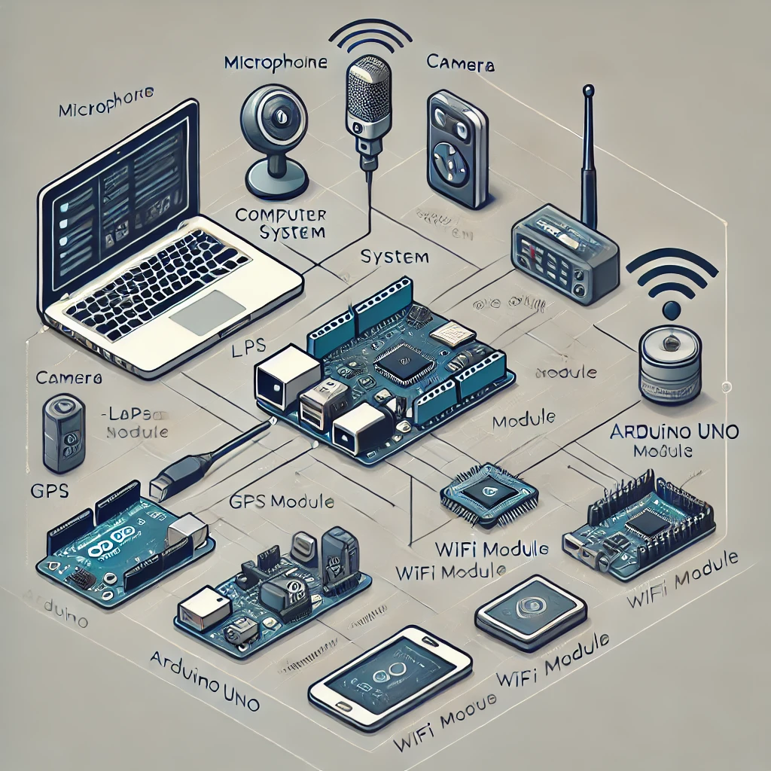
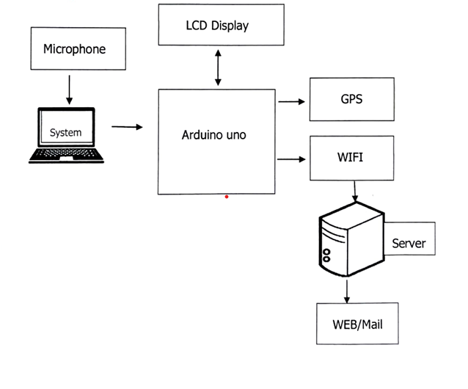
Block-Diagram

Slide 9
Expected Result
This system is designed to enhance public safety by automatically detecting incidents of harassment or molestation and quickly notifying authorities.
By capturing real-time evidence, such as videos and photos, and sending them to the nearest police station, it enables faster law enforcement responses, potentially preventing harm and ensuring offenders are apprehended.
The presence of such a system serves as a powerful deterrent, reducing crime rates by discouraging unlawful behaviour.
It also provides law enforcement with reliable, time-stamped evidence to aid investigations and support legal action. Advanced machine learning algorithms ensure the system accurately identifies genuine distress signals, minimizing false alarms.
Its adaptable and scalable design makes it suitable for various environments, including public spaces, workplaces, schools, and other vulnerable areas.
This project empowers communities by creating a sense of security, especially for vulnerable groups, while showcasing how Al-integrated CCTV systems can transform traditional surveillance into a proactive solution.

Slide 10
Applications
Public Safety and Smart City Surveillance:
Deploying this AI-driven system in public spaces like parks, streets, railway stations, and malls helps detect distress situations in real time.
It enhances smart city security by integrating with existing CCTV networks, reducing crime, and improving emergency response times.
Women and Child Safety:
The system can be installed in public transport, workplaces, and residential areas to detect harassment, molestation, or assault.
It enables quick intervention by law enforcement and helps prevent crimes against vulnerable individuals.
Educational Institutions (Schools & Universities):
Helps in monitoring and preventing bullying, violence, and harassment on school or university campuses.
Provides real-time alerts to security personnel, ensuring a safe learning environment for students and staff.

Slide 11
Applications
Hospitals and Mental Health Facilities:
Detects distress sounds from patients in emergency rooms, psychiatric wards, or elderly care facilities who may need urgent medical assistance.
Assists healthcare professionals in identifying patients experiencing pain, panic, or life-threatening conditions.
Home Security and Workplace Safety
Integrates with home security systems to detect domestic violence, break-ins, or emergencies.
In workplaces, it helps identify threats, workplace violence, or harassment, ensuring a safer environment for employees.

Slide 12
Conclusion
The Recognition of Anti-Molestation Situation Using Voice and Machine Learning project successfully demonstrated how AI can be leveraged to enhance public safety. By combining machine learning, audio processing, and video surveillance, the system was able to detect distress sounds in real-time and provide immediate alerts to authorities.
Through PyTorch and Librosa, the model efficiently identified distress signals such as screams, while OpenCV enabled seamless CCTV camera integration for capturing video evidence. Node.js facilitated real-time notifications, ensuring a swift response, and MySQL provided structured data storage for effective tracking and analysis of incidents.
This project not only highlights technical expertise in AI and system integration but also underscores the real-world impact of such solutions in emergency response systems. By automating distress detection and reducing response times, the system offers a proactive approach to improving security and preventing crimes.
Future enhancements, such as integrating multilingual audio recognition, improving model accuracy, and expanding deployment across different environments, can further strengthen its effectiveness. With continued innovation and real-world implementation, this solution has the potential to make public spaces significantly safer.

Slide 13
References
[1] Arunadevi S. Khaple, Aadarsh Chandanvandan, Aditi Jadhav, Akshada Jadhav, & Mohit Kasar. (2023). Online Child Predator Detection Using ML. International Journal of Scientific Research in Science and Technology, 446–451. https://doi.org/10.32628/IJSRST52310396
[2] Borj, P. R., Raja, K., & Bours, P. (2023). Online grooming detection: A comprehensive survey of child exploitation in chat logs. Knowledge-Based Systems, 259, 110039-. https://doi.org/10.1016/j.knosys.2022.110039
[3] Cardei, C., & Rebedea, T. (2017). Detecting sexual predators in chats using behavioral features and imbalanced learning. Natural Language Engineering, 23(4), 589–616. https://doi.org/10.1017/S1351324916000395
[4] Dorasamy, M., Kaliannan, M., Jambulingam, M., Ramadhan, I., & Sivaji, A. (2021). Parents’ Awareness on Online Predators: Cyber Grooming Deterrence. Qualitative Report, 26(11), 3683–3723. https://doi.org/10.46743/2160-3715/2021.4914

Slide 14
References
[5] OpenCV Documentation – https://docs.opencv.org/
Covers computer vision techniques useful for integrating CCTV footage processing in real-time security applications.
[6] Librosa: Python Library for Audio and Music Analysis – https://librosa.org/doc/main/
Provides details on extracting and analyzing audio features for distress sound classification.
[7] PyTorch Official Documentation – https://pytorch.org/docs/stable/index.html
Helps understand deep learning model implementation for sound classification.
[8] Generative AI CSAM is CSAM. National Center for Missing & Exploited Children. (2024, March). https://www.missingkids.org/blog/2024/generative-ai csam-is-csam

Slide 15
Thank You

